Slide 1
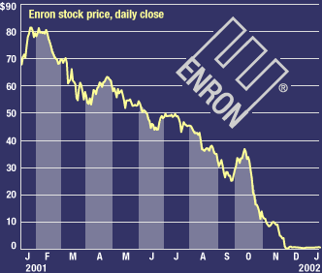
Stock Market prediction project
Exploratory data analysis
Taking out the emotion of
Trading
Look at the numbers/stats
Can we predict the next ENRON
Can we predict the next BOOM

Slide 2






Stocks in review

Slide 3
Some attributes - microsoft
 | Open | High | Low | Close | Volume | Ex-Dividend | Split Ratio | Adj. Open | Adj. High | Adj. Low | Adj. Close | Adj. Volume
Date
2004-08-19 | 100.01 | 104.06 | 95.96 | 100.335 | 44659000.0 | 0.0 | 1.0 | 50.159839 | 52.191109 | 48.128568 | 50.322842 | 44659000.0
2004-08-20 | 101.01 | 109.08 | 100.50 | 108.310 | 22834300.0 | 0.0 | 1.0 | 50.661387 | 54.708881 | 50.405597 | 54.322689 | 22834300.0
What happens if you want to forecast intraday?
1hrly, 30 Min, 1 min Time frame
Adjusted Data have to be dropped
Add MEAN, MID price to forecast?

Slide 4
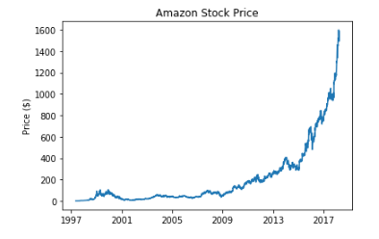
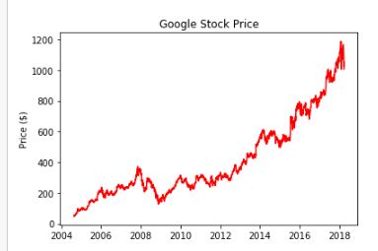
Amazon Google

Slide 5
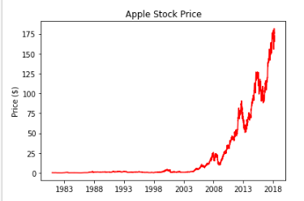
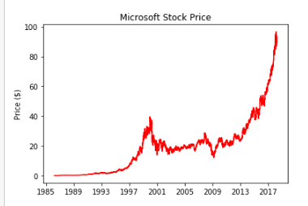
Apple microsoft

Slide 6
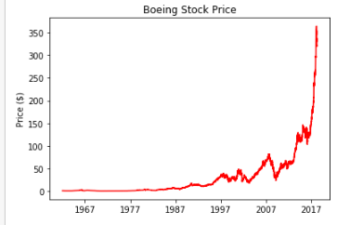
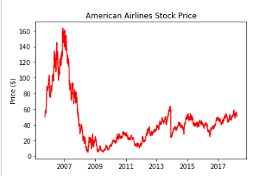
Boeing American airlines

Slide 7
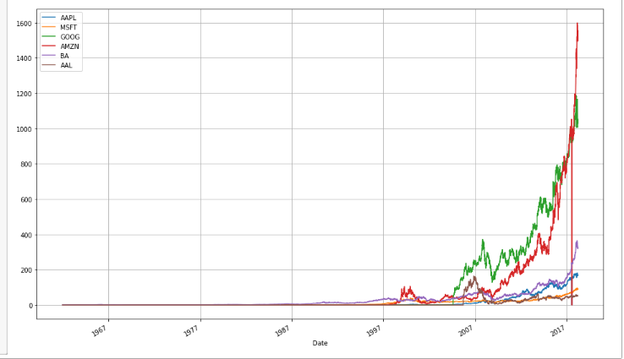
Compare all stocks on adjusted close price
Notes:
What’s wrong with this chart? While absolute price is important (pricy stocks are difficult to purchase, which affects not only their volatility but your ability to trade that stock), when trading, we are more concerned about the relative change of an asset rather than its absolute price. Google’s stocks are much more expensive than Apple’s or Microsoft’s, and this difference makes Apple’s and Microsoft’s stocks appear much less volatile than they truly are.

Slide 8
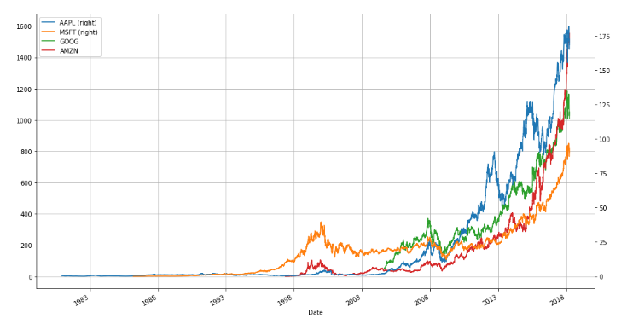
Technology stock scale against apple and Microsoft
Use 2 different Scale against Apple and Microsoft Stocks

Slide 9
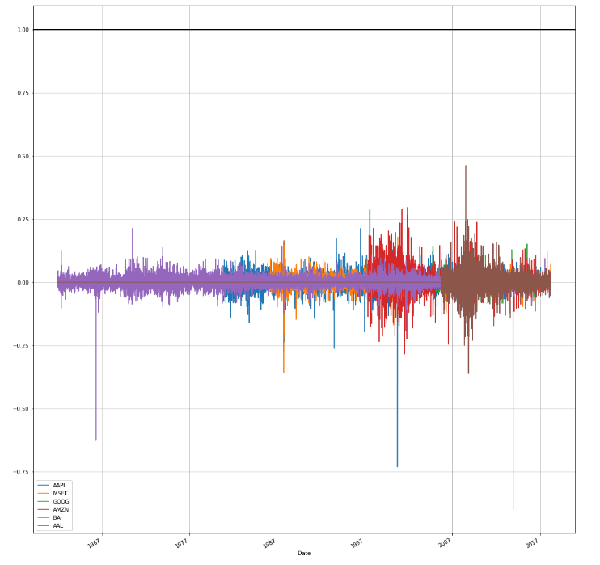
Stock change biggest SMALLEST – return log of all stock prices
AAPL 1980-12-12 MSFT 1986-03-13 GOOG 2004-08-19 AMZN 1997-05-16 BA 1985-09-30 AAL 2005-09-27
BIGGEST CHANGE:
AAPL 1980-12-12
MSFT 1986-03-13
GOOG 2004-08-19
AMZN 1997-05-16
BA 1985-09-30
AAL 2005-09-27
SMALLEST CHANGE:
AAPL 1981-08-10
MSFT 1987-10-19
GOOG 2008-09-29
AMZN 2017-08-07
BA 1985-09-27
AAL 2013-12-09

Slide 10
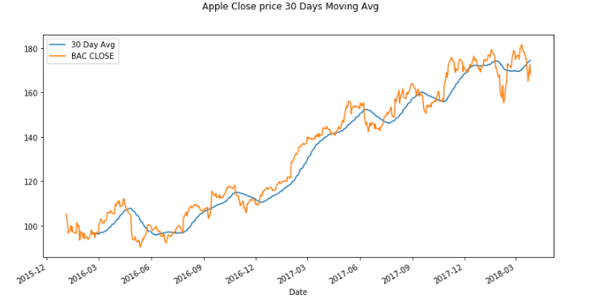
Apple 30 days Moving average 2016 - 2018

Slide 11
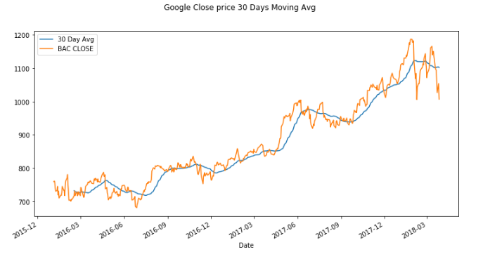
Google 30 days moving average 2016 - 2018

Slide 12
Can we predict the market
Can we predict the next 30, 10, 5 days or next 1 month where the stock will be heading?
Can we predict a down turn in the stock like Enron or American Airlines?
Will the stock keep forever going up?
Can we predict a price correction?
Let’s find out how accurate we can predict via Machine Learning – Till the next chapter.

Slide 13
Next step
Data preprocessing
Built a model

